Slide 1


Slide 2
SCALE(up) ALPS
Accelerate and promote the Alpine Start-up Ecosystem
The Alpine Space includes top innovative areas in Europe with great potential to grow an innovative entrepreneurship. Local and regional innovation ecosystems successfully support the creation of new business.
Scale(up)Alps aims to lead the way for making the Alpine Space (AS) as an innovative hub on the international level. The project focuses on one of the most critical phases of the enterprise lifecycle: the scaling up phase.

Slide 3
 AGENDA
Background: Interreg Alpine Space Programme
About the Project
Who we are
Get in touch with us

Slide 4

 Background: Interreg Alpine Space Programme
The Alpine Space programme is a European transnational cooperation programme for the Alpine region.
Financing: European Regional Development Fund (ERDF); public and private cofinancing from partner countries

Slide 5

 About the Project
1.793.944,55
( ERDF 1.424.602,12)
November 1st 2016
April 30th 2019
The aim of the Scale(up)Alps project is to foster the scaling up of Alpine Space (AS) scale up branding the AS as a cooperative area for innovative businesses and job creation.
The project is about improving funding opportunities, finding the talent and a skilled workforce, developing leadership and facilitating access to markets.
The project’s main activities will be:
    connecting AS ecosystem policies & communities of practice;
    selecting policies that expand the quantity and the quality of AS serial entrepreneurs and fast-growing scalable ventures;
    producing a mid-level feasibility plan with high level recommendations on start-up ecosystems’ growth and reducing fragmentation and therefore increasing collaboration across disciplines & stakeholders;
    designing & testing innovative public-private support schemes, matching corporate and capital, attracting talent, opening up market access and improving innovation within the entrepreneurial life cycle.

Slide 6
The process
IDEA
LAUNCH
PILOT
GROWTH
Policy community enhancing and capacity building
Policy model definition and intervention plan
Scale-ups support services
Exit strategy –sustainability-marketing plan
2016
2018

Slide 7
IDEA
LAUNCH
PILOT
GROWTH
    Alpine Peer Learning Labs
    Alpine Space Policy Action Groups
    Handbook about ecosystems and best practices in AS
    SWOT analysis of AS ecosystem
    Analysis of synergies and challenges of AS ecosystems
    Action plan/AS Road map
    Leadership Development Camp + Alpine Ecosystems Conference for stakeholders
    Identify policy enablers/funding programs on the local/regional/EU levels for full implementation of schemes
    Best 3 SMART support schemes as part of E-Handbook, so that they can be implemented
    MoU among PPs
    Stakeholder relationship-building strategy
    Innovation clusters become strategic hubs
    AS sustainability plan including risk assessment
    ALPINE LEVEL
    LOCAL LEVEL
    4 workshops
    Local Policy Action Group
    Questionnaire about local ecosystem
    Road map at local level
    Training for stakeholders
    Representation of local ecosystems using Start-up Ecosystem Canvas
    Growth Hacking Bootcamp for policy enablers
    Design and suggest support schemes for scale-ups/startups
    Increase visibility of exemplary scale-ups
    Share specific needs and/or restrictions of individual regions regarding startup/scale-up ecosystems and the participation of stakeholders

Slide 8
5. Contacts
WHO we are
PARTNERS:
Torino Chamber of commerce (coordinator), Torino, Italy
Metropolitan City of Turin, Torino, Italy
Veneto Innovazione, Venezia, Italy
Obrtno podjetniška zbornica Ljubljana, Slovenia
Tehnoloski park Ljubljana d.o.o., Ljubljana, Slovenia
UnternehmerTUR GmbH, Garching, Germany
Università della Svizzera italiana, Lugano, Switzerland
KWF Karntner Wirtschaftsforderungs Fonds, Kòagenfurt am Worthersee, Austria
IMC University of Applied Sciences Krems, Krems, Austria
French Riviera Chamber of Commerce and Industry, Nice Cedex 1, France
Regional Agency for Innovation and Internationalisation of companies in Provence-Alpes_Cote d'Azur Region, Marseille, France

Slide 9
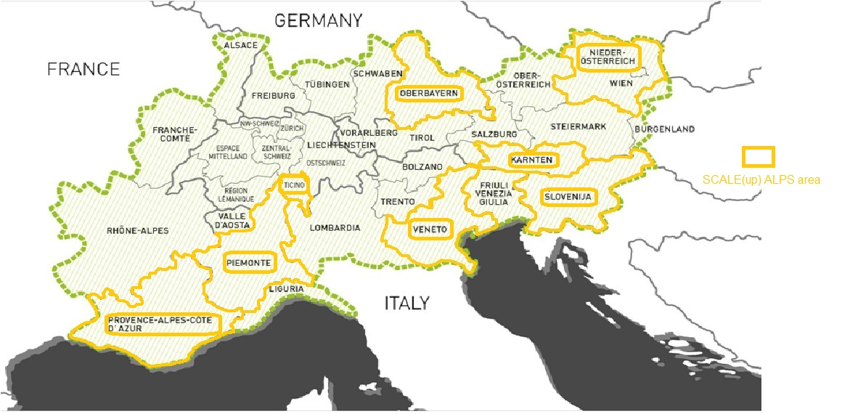
UnternehmerTUM GmbH
KWF | Kärntner Wirtschaftsförderungs Fonds
IMC Fachhochschule Krems
Università della Svizzera italiana
Obrtno podjetniška zbornica Slovenije
Tehnološki park Ljubljana d.o.o.
Agence Régionale pour l’Innovation et l’Internationalisation des Entreprises de Provence-Alpes-Côte d’Azur
Veneto Innovazione
Camera di Commercio Industria Artigianato Agricoltura di Torino (LP)
Chambre de Commerce et d'Industrie Nice Côte d’Azur
Città Metropolitana di Torino

Slide 10
GET IN TOUCH WITH US
www.alpine-space.eu/projects/scale-up-alps/en/home
Nicoletta Marchiandi Quatraro (Torino Chamber of commerce)
email: scalealps@to.camcom.it
Maria Sole D’Orazio (Veneto Innovazione spa)
email: mariasole.dorazio@venetoinnovazione.it

